Slide 1
Welcome Back! 2015-2016
2014-2015
ALL IN! OWN IT, BELIEVE IT, WORK HARD FOR IT
PART 2
”All IN”
Mission: Activate Learner
Reflect, Recharge, Reengage!

Slide 2
Agenda…
Welcome and Introductions
Over the Summer….
Purpose of the Title I Annual Meeting:
What is Title 1 and funding?
How can you get involved?
School-Parent Compact
Parent Involvement Plan/Policy
School Improvement Plan
What is our Mission as a school?
Additional Questions and/or Feedback

Slide 3
Materials: Agenda and Folder

Slide 4
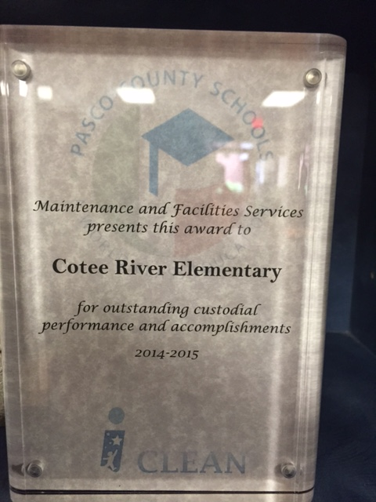
Over the Summer….
5th grade Science FCAT Data: Increase from 38-43!!!
Maintenance and Facilities Services B+ (only 13 schools)
Work Groups AND PD to get ready for the 2015-2016 school year ☺
4 teachers accepted and completed the St. Leo Technology Institute and will engage in action research throughout the school year

Slide 5
Over the Summer….
Scholastic News ordered grades K-5
ESE Self-Contained Materials ordered
IDE Portal purchased and available SAC
Reading Counts through SAC
Clothes and Food Pantry: Pack A Sack revamped: Start 9-4-15 and every Friday Morning
Community Outreach: Marine Auxiliary new partner

Slide 6
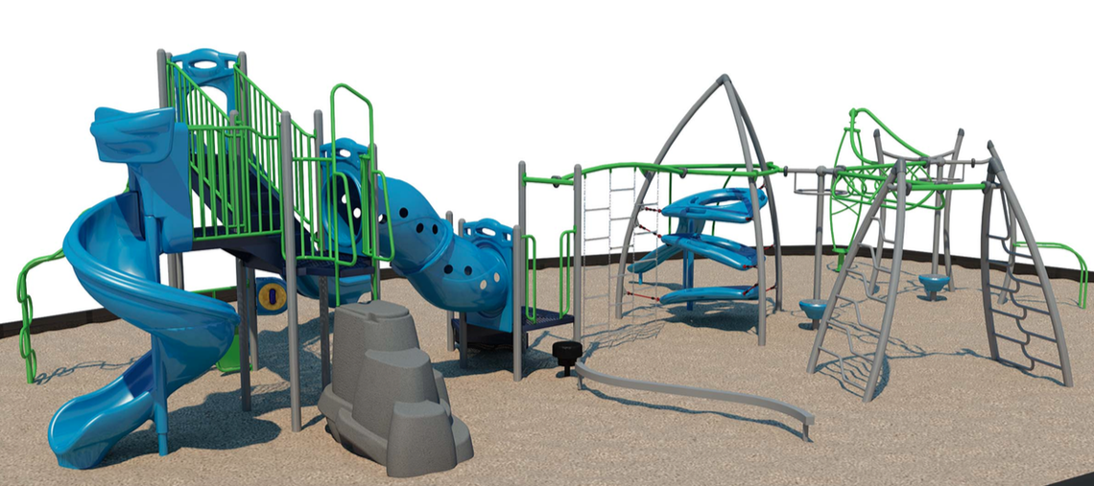
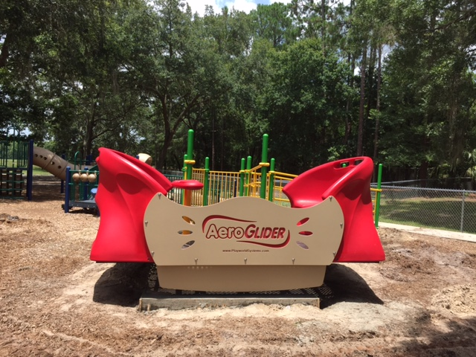
Over the Summer….
Outside Lighting
Roofing Project: Started June 8th
MPR/Cafeteria Door Installed
Painting of Hallways, Bathrooms and Office Area (some will continue)
New Office and Learning Lab Furniture
Playground: Aeroglide: Inclusive equipment and 1-5 playground on order

Slide 7
Purpose of Title 1 Annual Meeting
Provide information to parents of participating children about the Title I program and their right to be involved in their child’s education.

Slide 8
Title 1 is….
Federally Funded Program
Funding based on percentage of free and reduced lunch
Funding attempts to provide supplemental supports and resources

Slide 9
Schools may use Title 1 funds to:
Extend learning time: KG CAMP
Add additional instructional or non-instructional staff: LEARNING DESIGN COACH
Support parent and community involvement efforts: PARENT INVOLVEMENT COORDINATOR
Provide professional development: ADDITIONAL PLC FACILITATORS FOR GRADES K-5 (ELA AND STEM)
Purchase additional instructional materials and supplies
Purchase technology
Provide resources that encourage and support parents in becoming more involved in their child’s education

Slide 10
How Can You Get Involved?
Registration/Meet the Teacher Day
Attend Annual Title 1 Meeting
Open House
Schedule conferences with your child’s teacher
Become familiar with our school’s: Parent Involvement Plan, School Compact and School Improvement Plan (See handouts)
Join our School Advisory Board (SAC): take part in developing our PIP and SIP
Make suggestions and complete surveys as they come out
Sign up to be a volunteer
Take part in school-wide events: PTA, iMOM/All Pro Dads, Watch Dog Dads, Community Events
(Visit the Cafeteria for more information on how to get Involved)

Slide 11
WHAT IS OUR MISSION AS A DISTRICT AND A SCHOOL?

Slide 13
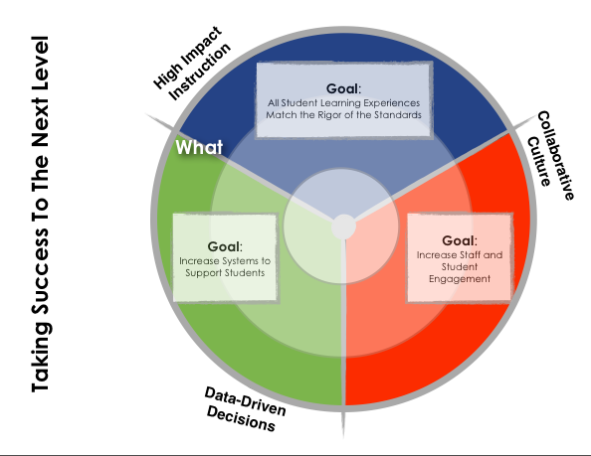
Specific expectations for our system

Slide 14
We can be the best school not by luck or chance but if we…
The only barriers and limits we have are the ones we create.
Truly are ALL IN! This is a passion, a career- not just a job
Truly believe ALL children can learn even if it is at a different pace and a different way
All Work Together through collaboration and learn from each other
All Implement research based practices and make data driven decisions
Truly reflect on our current practices and set goals to continue to grow

Slide 15
SCHOOL-WIDE MISSION 4 focus areas
Is it what’s best for our students?

Slide 16
CRES Shared Vision
ROAD MAP TO SUCCESS: SCHOOL-WIDE FOCUS AREAS
SCHOOL/DISTRICT-WIDE ASSESSMENTS
SCHOOL-PARENT COMPACT
PARENT INVOLVEMENT PLAN (PIP)
SCHOOL IMPROVEMENT PLAN (SIP)
Notes:
Refer to handouts:
CRES Shared Vision- 1 sided
Semester 1 and 2- front to back
Compact- front to back
Family Friendly PIP- front to back
SIP- front to back and stapled

Slide 17
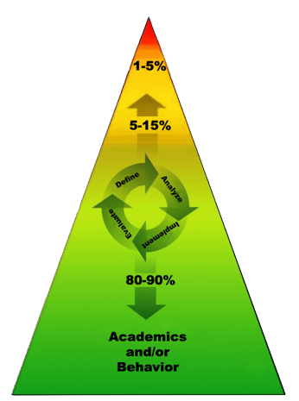
Data-based problem solving to integrate academic and behavioral instruction and intervention Instruction and intervention is provided to students at varying levels based on need Goal is to prevent problems and intervene early so all of our students can be successful
MTSS Framework (Multi-Tiered System of Supports):

Slide 18
“Engaged” staff members work with passion and drive innovation and continue to move our organization forward.
Loving what you do is contagious!

Slide 19
GOAL 1 : Professional Learning Communities
Fluid Dialogue Around:
5 Guiding Questions
Inquiry Cycle

Slide 20
Pasco’s Integrated System
PLCs Look Like and Sound Like:
Focus on Learning (deepening our understanding of standards and tasks that align with the intention of the standards)
Focus on Collaboration
Focus on results: (Data Driven Decisions
Every PLC should include:
Group Norms and Roles
Agenda (Guiding Questions and Inquiry Cycle)
Celebrations
Minutes with Next Steps/Follow up Responsibilities
(Agendas/Minutes due at the end of each month, which includes short and extended PLCs)
NOTE: PLC Rubric

Slide 21
GOAL 2 : Parent Involvement
Build Relationships with Families and Community Partners
Increase Involvement

Slide 22
Ways to Increase:
Parent Involvement Coordinator
Minimum 1x per semester parents invited to classroom lesson with their child
Marine Auxiliary New Partner
IRLA Night K-3
FSA 3-5
Optional Parent Conference Night (1 x per semester)

Slide 23
We set the tone for each child’s day. How do you provide “hope” for our students by seeing something in them they might not even see themselves?

Slide 24
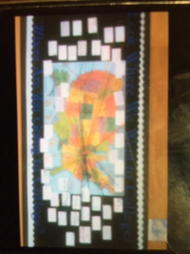
GOAL 3 : Social Emotional Learning (PBIS Mission)
Personal Growth
Sense of Community and Belonging
Hope Board (Career/College Board) Path you took after high school…
Notes:
College Board- location 5th grade hallway.

Slide 25
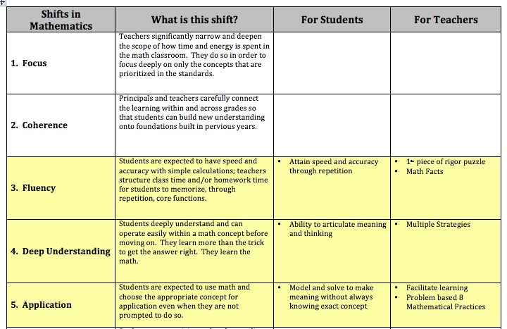
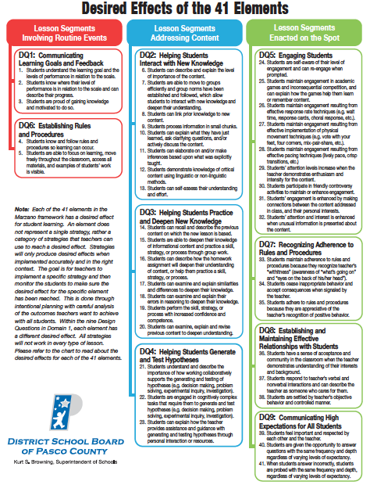
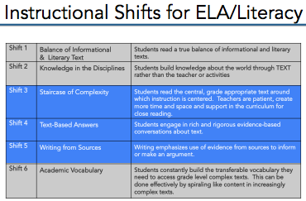
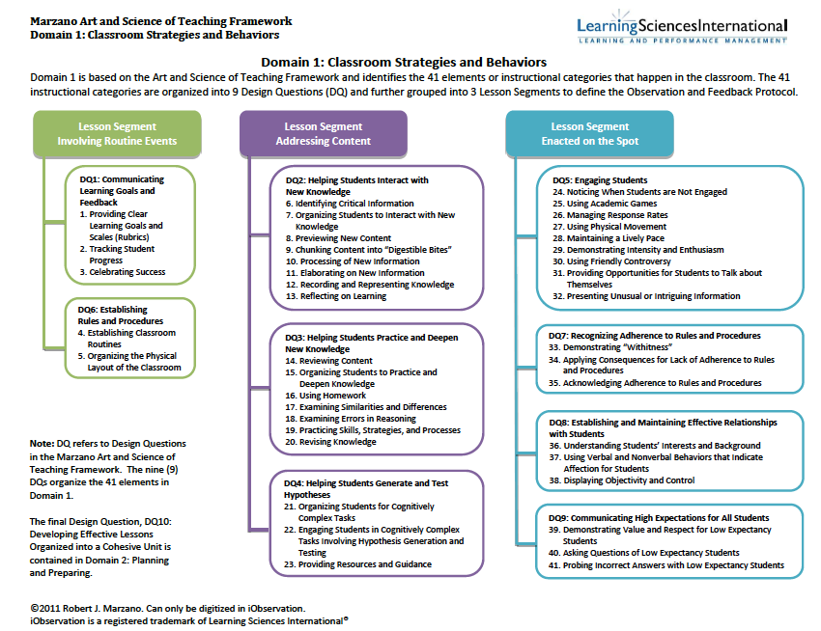
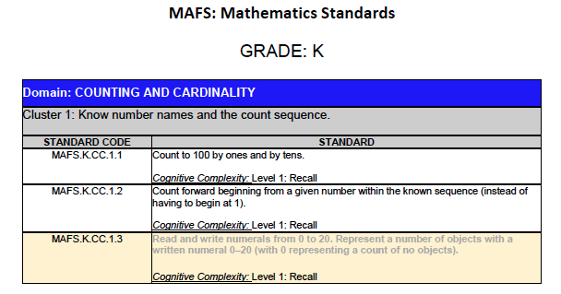
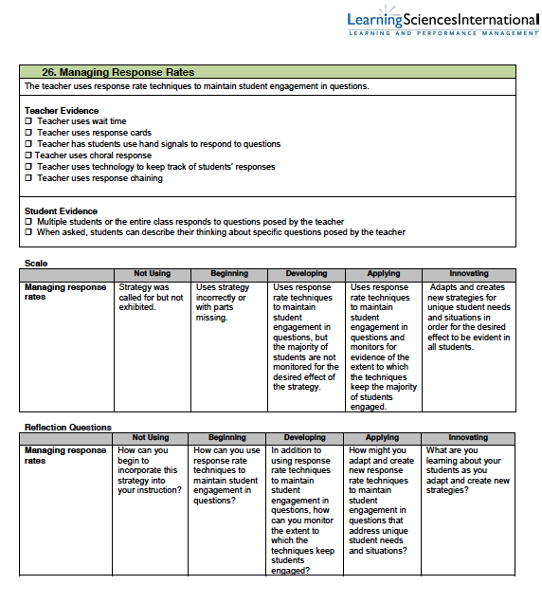
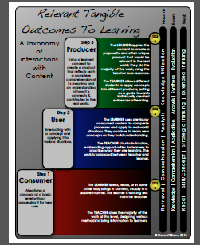
GOAL 4: Intentional Planning
Standards-Based (Understanding Depth and Progression)
ELA and Math Shifts
Student Centered Learning: Intentional Planning for Infusion of Technology and Authentic Tasks

Slide 26
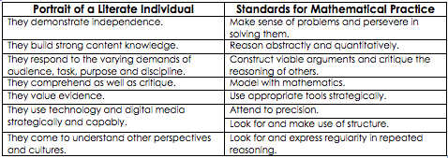
High Impact Instruction
Tools: Florida Standards
Instructional Framework
Strategic Professional Development

Slide 27
Student Centered Learning Our Students will be able to…
Build strong content knowledge and apply their learning to new contexts
Think critically to understand and solve real world problems
Collaborate and communicate to learn within and outside of their school community
Utilize a variety of tools and resources to enhance their learning
Take ownership of their learning and reflect on their learning process

Slide 28
School-Wide Focus Summary
PLCs: Collaborative Culture/Data Driven Decisions
Parent Involvement: Build relationships
Social Emotional Learning : Personal Growth/Sense of Belonging
Intentional Planning: High Impact Instruction

Slide 29
Complacency is the enemy of change….
Challenge:
Be the Change!

Slide 30
ARE YOU ALL IN?
Notes:
Insert highlights/pages

