Slide 1

Lightning Flash Newsletter
7515 Plathe Road New Port Richey, FL 34653
727-774-3000
727-774-3091 Fax
Sharon Slusser, Principal
Dan Wolfe, Asst. Principal
October 06, 2020
10/08 – Virtual Coffee Talk w/Parents, 10:00-11:00 am
10/09 – Kick off Read-a-Thon Fundraiser
10/15 – Fall Picture Retakes
10/16 – End of First Quarter
10/19 – No School (Teacher Planning Day)
10/21 – Unity Day (Scholars wear orange Today)
10/22 – Virtual SAC Meeting, 4:30 pm
10/23-10/31 – Red Ribbon Week (See Details Below)
10/23 – CRES Read-a-Thon via Zoom for MSOL Scholars & traditional will take place in the classroom.
10/26 – Scholar of the Month, Facebook Live
10/26 – Virtual PTA Meeting, 4:30-5:30 pm
10/27 – Report Cards Online in PM
Cotee River Read-a-Thon
This year we are launching a NEW fundraiser that not only supports our school, but also supports each scholar's personal reading development goal. This fundraiser will be supporting teacher and classroom needs such as scholar incentives, books and learning materials. Kick off will be on October 9th and will be completed on October 23rd.
How It Works:
Make a pledge to encourage reading and raise money for Cotee River Elementary School. Scholars will have two weeks to collect pledges before a school wide reading event on Friday, October 23, 2020 during their scheduled reading time. Scholars will read or be read to for a total of 60 minutes.
Two Ways to Make a Pledge:
(Our Goal $18,000 if each scholar gave $30.00, we can meet our goal.)
FLAT DONATION - You can sponsor a scholar with a flat amount. If you pledge a flat donation of $25, no matter how much the scholar reads you will owe $25.
PLEDGE PER MINUTE - You can pledge an amount for minutes read. For example, scholars will be reading 60 minutes on the day of the Read-A-Thon. If you sponsored a student for 25 cents, you will owe .25 cents x 60 minutes = $15.
Your Scholar's Pledge Page:
To find your child’s online pledge page, please follow these 3 easy steps:
Go to this link - www.99pledges.com/fund/CoteeRiver2020
Type your child’s name in the "search for participant" bar.
Click on your child’s name and that will take you to their online pledge page!
You do not need to log in or change anything. All you have to do is make a donation for whatever amount you can and share your child’s page with friends and family. We are shooting for 100% participation, so no amount is too small.
Awards & Giveback:
Top Class for each grade level will receive 10% give back to the classroom based on what is collected.
Top scholar for each classroom will receive $25.00 towards a Scholastic Book order.
Too Sick for School - Students experiencing COVID-19 like illness during the school day must be excluded from school. According to current guidelines from the CDC, common COVID-19 symptoms among children may include:
Fever (greater than 100.4).
Sore throat.
New uncontrolled cough, that causes difficulty breathing (for students with chronic allergic/ asthmatic cough, a change in their cough from baseline).
Diarrhea, vomiting or abdominal pain.
New onset of severe headache, especially with a fever. ***
Other symptoms listed by the CDC include chills, fatigue/muscle or body ache, new loss of taste or smell, and congestion or runny nose. Many children have very mild or no signs or symptoms of illness.
We realize that some of these symptoms are common in other childhood illnesses like cold, flu, seasonal allergies and asthma. Trained health staff will consult with registered school nurses (RNs) to make the best decision regarding exclusion that will keep our school community safe.

Slide 2

Recycling
CRES Clothing Closet If your family is in need of any clothing items, we invite you to contact Mrs. Miller or Ms. O’Brien to set up a time during the school day to come in and get what you need. In the event transportation and/ or timing is an issue, we have created a form which can be sent home upon request (please call the front office). When we receive the request form, we will call your child/ children down to pick out the items requested and send them home in their backpack.
Did you know that CRES has a green dumpster (located at the front of the school along the loop, by the PLACE turn off) where you can donate ANY kind of paper good for for recycling? Help us to help the environment by saving all the paper trash including newspaper, cardboard, and packaging. By placing these items in our green dumpster, you also help CRES earn $$$$! Every little bit helps. Also we have battery recycling drop off at the front enterence of the office. CRES will have our Earth Patrol Scholars again this school year, each week we go around our campus and clean up the area. We appreciate your support.
Weekly Connect Ed Calls/Messages:
If you receive calls from (844) 400-9765 these calls are Connect Ed messages from Cotee River Elementary and/or Pasco County Schools. Please be sure to listen to the important information being shared with parents regarding school events and weekly reminders.
Cotee River Elementary
Business & Community Partners:
Achieva Credit Union, Rowan Rd.
All Children’s Hospital
GTE Finanical Credit Union
Horace Mann Insurance
Kona Ice
Madison Restaurant
Marjorie’s Hope
Millian-Aire Corp.
Publix, River Crossing
Smitty’s Mobile Detailing
Target #1967, Little Rd.
Timber Greens Helping Hands
UBS, Clearwater
Walgreens #06886
Thank you for supporting our school! To become a CRES partner please call Ms. O’Brien at the Main Office for more information. 727-774-3002

Slide 3
Free Reduce Meals - On October 5th, your student’s free or reduced status will be expiring. Currently, all students are eligible to receive free breakfast and lunch, regardless of their eligibility status. Free meals will be available until December 31st. However, we still strongly encourage you to complete a new meal application if your household still qualifies. In addition to the meal benefits that will become effective on January 1st, students eligible for free or reduced-price meals can receive free or discounted testing fees, camp registrations, high-speed internet, and other benefits. School’s also receive a portion of their funding based off the percentage of students who qualify for free or reduced-price meals based off their household meal application, regardless of whether that student is attending MySchoolOnline or in person.
To review the eligibility guidelines and complete an application, please visit www.pascoschoolmeals.com.
Out-of-Field Teaching Assignments
Individuals who are teaching out-of-field are certified in at least one area and are qualified to teach but are required to take additional course work or testing to add a coverage/endorsement to their certificate. The state also requires a teacher to take coursework/inservice towards an English for Speakers of Other Languages (ESOL) endorsement, when the teacher is the primary language arts provider and/or reading teacher for an ESOL student.
The following teachers have agreed to teach outside their field while completing their course work/in-service/exams:
Lloyd, Cameron Exceptional Student ED K-12
Schaffer, Joan Gifted Endorsement
Toy, Glenn Exceptional Student ED K-12
The following teachers have completed their requirements, and their certificates are pending: NA
The following teachers have agreed to work to obtain the ESOL endorsement:
Cappel, Amanda Cullen, Felicia Emert, Catherine
Leonard, Kenneth Selvey, Amy Telleri, Katharine
Triana, Melissa

Slide 4
IRLA School Pace - IRLA School Pace - This allows scholars access to their current color reading level from a device. IRLA School Pace (can gain access through their myPascoConnect account).
Volunteers Needed - We are still able to have volunteers to assist the following ways: come in and help in the Media Center, read with children via Zoom, help in the clothing closet, ask teachers for things that you could do from home. Once COVID-19 guidelines are modified we will be able to have volunteers back in our classrooms working with children.
Fall Picture Retakes – October 15th will be picture retakes and new scholars that came to CRES after September 3rd. If you have a child through MSOL platform, please call front office to schedule appointment for that day. Any questions please contact the front office.

Slide 5


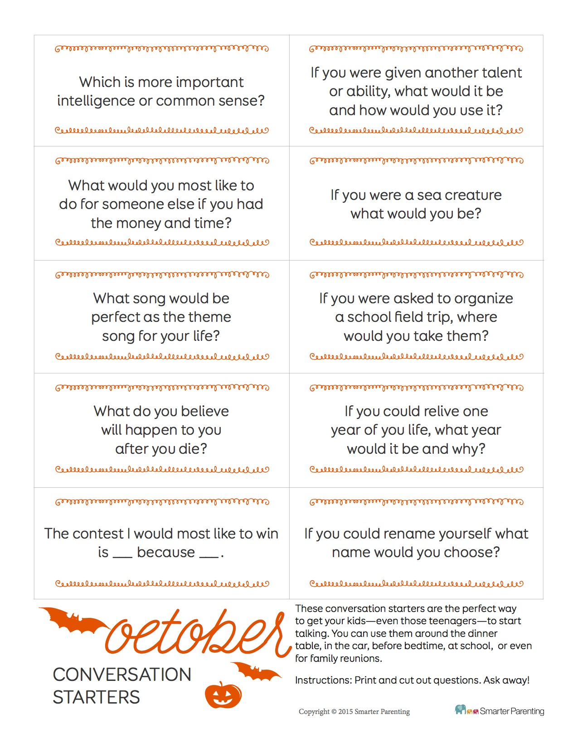





OCTOBER 2020
Thursday 10/8/2020
@ 10am via Zoom!
Meeting ID: 81523418954
Passcode: 632185
MONDAY OCTOBER 26TH
4:45PM ON ZOOM!
We are looking for volunteers!
Please fill out an application at
http://www.pasco.k12.fl.us/comm/volunteer

