Slide 1


Lightning Flash Newsletter
7515 Plathe Road New Port Richey, FL 34653
727-774-3000
727-774-3091 Fax
Sharon Slusser, Principal
Dan Wolfe, Asst. Principal
February 02, 2021
February Calendar
02/01-02/19 – LLS Hero Squad Fundraiser
02/02 – Special Olympics Soccer Practice, 4:10-4:55 pm
02/03 – Early Release Day @ 2:08 pm
02/04 – Special Olympics Cheer Practice, 4:10-4:55 pm
02/05 – Progress Reports Online in PM
02/09 – Special Olympics Soccer Practice, 4:10-4:55 pm
02/11 – Virtual Coffee Talk w/Parents, 10:00-11:00 am
02/11 – Special Olympics Cheer Practice, 4:10-4:55 pm
02/15 – No School – President’s Day
02/16 – Special Olympics Soccer Practice, 4:10-4:55 pm
02/18 – Special Olympics Cheer Practice, 4:10-4:55 pm
02/22 – Scholar of the Month , PreK-2nd 10:00-10:30 & 3rd-5th 10:30-11:00 am, Facebook Live
02/22 – PTA Meeting via Zoom, 4:45 pm
02/23 – Special Olympics Soccer Practice, 4:10-4:55 pm
02/24 – Kick Off World’s Finest Chocolates Fundraiser (Permission Slip Go Home Today)
02/25 – World’s Finest Chocolates Box goes home if we received signed permission slip
02/25 – Special Olympics Cheer Practice, 4:10-4:55 pm
02/25 – SAC Meeting via Zoom, 4:30 pm
02/27 – Special Olympics Regional Basketball, RADD Sports, Wesley Chapel, 10:00-5:00 pm
Spring Parent ESOL Meeting - Next February 10th, the Pasco Schools ESOL department will host the 2021 Spring Parent Leadership Council Meeting via ZOOM, from 6:00 to 7:00 pm. The meeting will touch on topics such as:
What is the ESOL Program
Who is an English Language Learner
ELL parent's rights
ESOL services
WIDA
Parents are required to register using the flyer's information to obtain the ZOOM link via email, which will be sent on the day of the meeting. You can also provide ESOL parents the link as follows:
www.pasco.k12.fl.us/esol/page/parents

Slide 2
Free Reduce Meals Update - Currently, all students are eligible to receive free breakfast and lunch, regardless of their eligibility status. Free meals will be available until December 31st. However, we still strongly encourage you to complete a new meal application if your household still qualifies. In addition to the meal benefits that will become effective on January 1st, students eligible for free or reduced-price meals can receive free or discounted testing fees, camp registrations, high-speed internet, and other benefits. School’s also receive a portion of their funding based off the percentage of students who qualify for free or reduced-price meals based off their household meal application, regardless of whether that student is attending MySchoolOnline or in person.
To review the eligibility guidelines and complete an application, please visit www.pascoschoolmeals.com.
Weekly Connect Ed Calls/Messages:
If you receive calls from (844) 400-9765 these calls are Connect Ed messages from Cotee River Elementary and/or Pasco County Schools. Please be sure to listen to the important information being shared with parents regarding school events and weekly reminders.
Too Sick for School - Students experiencing COVID-19 like illness during the school day must be excluded from school. According to current guidelines from the CDC, common COVID-19 symptoms among children may include:
Fever (greater than 100.4).
Sore throat.
New uncontrolled cough, that causes difficulty breathing (for students with chronic allergic/ asthmatic cough, a change in their cough from baseline).
Diarrhea, vomiting or abdominal pain.
New onset of severe headache, especially with a fever. ***
Other symptoms listed by the CDC include chills, fatigue/muscle or body ache, new loss of taste or smell, and congestion or runny nose. Many children have very mild or no signs or symptoms of illness.
We realize that some of these symptoms are common in other childhood illnesses like cold, flu, seasonal allergies and asthma. Trained health staff will consult with registered school nurses (RNs) to make the best decision regarding exclusion that will keep our school community safe.

Slide 3

Recycling
CRES Clothing Closet If your family is in need of any clothing items, we invite you to contact Mrs. Miller or Ms. O’Brien to set up a time during the school day to come in and get what you need. In the event transportation and/ or timing is an issue, we have created a form which can be sent home upon request (please call the front office). When we receive the request form, we will call your child/ children down to pick out the items requested and send them home in their backpack.
Did you know that CRES has a green dumpster (located at the front of the school along the loop, by the PLACE turn off) where you can donate ANY kind of paper good for for recycling? Help us to help the environment by saving all the paper trash including newspaper, cardboard, and packaging. By placing these items in our green dumpster, you also help CRES earn $$$$! Every little bit helps. Also we have battery recycling drop off at the front enterence of the office. CRES will have our Earth Patrol Scholars again this school year, each week we go around our campus and clean up the area. We appreciate your support.
Out-of-Field Teaching Assignments
Individuals who are teaching out-of-field are certified in at least one area and are qualified to teach but are required to take additional course work or testing to add a coverage/endorsement to their certificate. The state also requires a teacher to take coursework/inservice towards an English for Speakers of Other Languages (ESOL) endorsement, when the teacher is the primary language arts provider and/or reading teacher for an ESOL student.
The following teachers have agreed to teach outside their field while completing their course work/in-service/exams:
Lloyd, Cameron Exceptional Student ED K-12
Schaffer, Joan Gifted Endorsement
Toy, Glenn Exceptional Student ED K-12
The following teachers have completed their requirements, and their certificates are pending: NA
The following teachers have agreed to work to obtain the ESOL endorsement:
Cappel, Amanda
Cullen, Felicia
Emert, Catherine
Telleri, Katharine
Triana, Melissa
Selvey, Amy
Cotee River Elementary
Business & Community Partners
Achieva Credit Union, Rowan Rd.
All Children’s Hospital
GTE Finanical Credit Union
Horace Mann Insurance
Kona Ice
Madison Restaurant
Marjorie’s Hope
Millian-Aire Corp.
Publix, River Crossing
Smitty’s Mobile Detailing
Target #1967, Little Rd.
Timber Greens Helping Hands
UBS, Clearwater
Walgreens #06886
Thank you for supporting our school! To become a CRES partner please call Ms. O’Brien at the Main Office for more information. 727-774-3002
Out-of-Field Teaching Assignments
Individuals who are teaching out-of-field are certified in at least one area and are qualified to teach but are required to take additional course work or testing to add a coverage/endorsement to their certificate. The state also requires a teacher to take coursework/inservice towards an English for Speakers of Other Languages (ESOL) endorsement, when the teacher is the primary language arts provider and/or reading teacher for an ESOL student.
The following teachers have agreed to teach outside their field while completing their course work/in-service/exams:
Lloyd, Cameron Exceptional Student ED K-12
Schaffer, Joan Gifted Endorsement
Toy, Glenn Exceptional Student ED K-12
The following teachers have completed their requirements, and their certificates are pending: NA
The following teachers have agreed to work to obtain the ESOL endorsement:
Cappel, Amanda Cullen, Felicia Emert, Catherine
Leonard, Kenneth Selvey, Amy Telleri, Katharine
Triana, Melissa

Slide 4
IRLA School Pace - IRLA School Pace - This allows scholars access to their current color reading level from a device. IRLA School Pace (can gain access through their myPascoConnect account).
Volunteers Needed - We are still able to have volunteers to assist the following ways: come in and help in the Media Center, read with children via Zoom, help in the clothing closet, ask teachers for things that you could do from home. Once COVID-19 guidelines are modified we will be able to have volunteers back in our classrooms working with children.

Slide 5
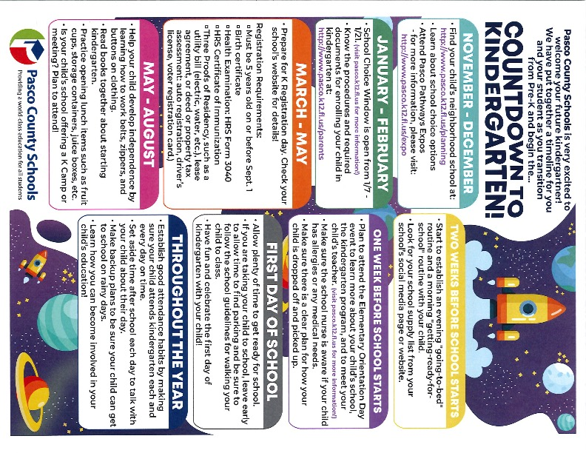
Friendly Reminders – Please send
change of clothes to keep in your child’s
backpack. Also, if your child is missing a jacket or sweeter, please have them check our lost and found in the front office hallway.
World’s Finest Chocolate Fundraiser – February 24th CRES will be kicking off our chocolate fundraiser with World’s Finest Chocolates, watch for the permission slip to come home that afternoon. Return slip completed by parent/guardian on the 25th and you will receive a lanyard and Coop collectible. Chocolates will be $1.00 per bar with 60 bars per box. On the permission slip it will have all the details of prizes. All monies must be returned before getting another box. No returning of unsold boxes. All monies is due in by March 10th.
Scholar Absence – It shall be the responsibility of
each parent/guardian to notify & justify the absence
of his/her scholar. Parent/guardian are encouraged to telephone the school during a scholar’s absence and request assignments if the absence is anticipated to be two or more days.
Upon the scholar’s return the parent/guardian must provide written justification for their scholar’s absence. Failure to do so within three (3) days will cause the absence to be recorded as “unexcused”.

Slide 6





February 2021
Thursday 2/11/2021
@ 10am via Zoom!
Meeting ID: 2154701929
Passcode: 143143
PTA Meeting!
Feb 22nd Meeting Via Zoom @ 5pm
I love you Rituals!
Parents
Care at CRES

